Slide 1
Nyc doh ratings
Group 7: Emma Pang, jenny yi, Lauren McKinzie, Regana Alicka, Steve Li

Slide 2

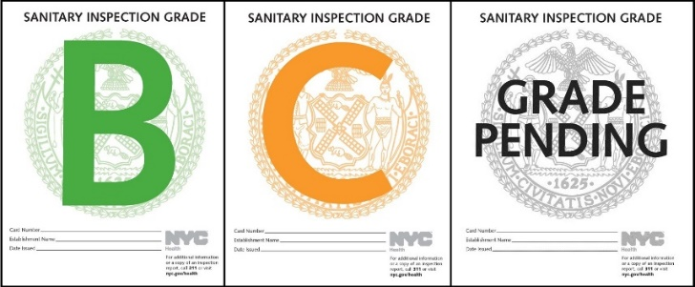
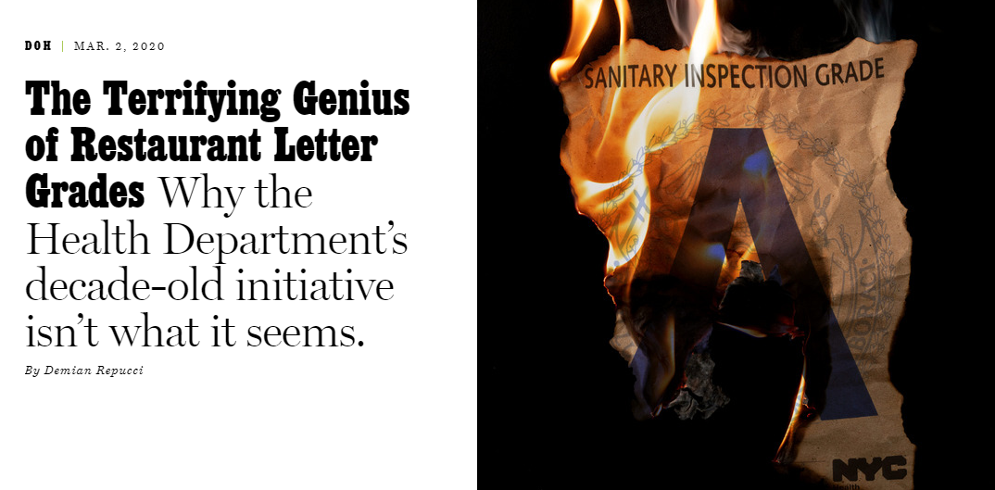
RESEARCH APPROACH
CONTEXT
The Department of Heath (DOH) is responsible for conducting restaurant health inspections on all food-handling, food-service establishments in NYC.
A restaurant’s score corresponds to a letter grade. The lower the score AKA the less violation points, the better the grade. Each violation incurs a penalty fee.
MOTIVATION
A recent article on Grubstreet questioned the current penalty fee-heavy system, asking if the motivation for these penalties were truly stemming from public safety concerns or a cleverly design revenue generator for the DOH.
Violation 22A: "Nuisance created or allowed to exist. Facility not free from unsafe, hazardous, offensive or annoying conditions.“
“Often, other violations made no sense at all, or the inspectors didn’t listen if you told them they were wrong.”
“It always struck me as simply odd, or as one more way for the city to cite restaurant owners and extract some extra cash.”

Slide 3
RESEARCH APPROACH
OBJECTIVE
Using the DOH’s public data on restaurant violations and grades, figure out what the distribution of grades are in NYC:
How many restaurants have A, B, C ratings? And where are they?
Is there a specific area with a higher concentration of a rating?
What are the most common types of violations?
VISION
Create a website with a leaflet map visual to look at A, B, C restaurant ratings in NYC and use plot.ly charts to summarize the data.

Slide 4

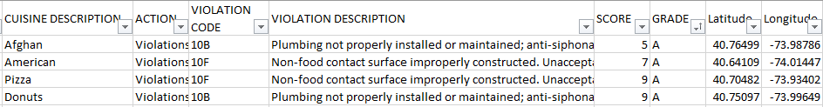

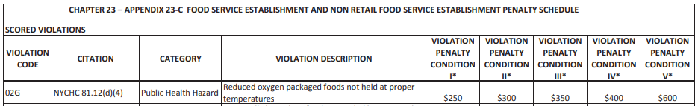
Data sources
1. March 2020 NYC Restaurant Inspection Results 430K Rows, 26 Columns
2. DOH Violation Penalty Dictionary
Notes:
Those >50YO are more likely to dislike rigid fabric and wide leg.

Slide 5
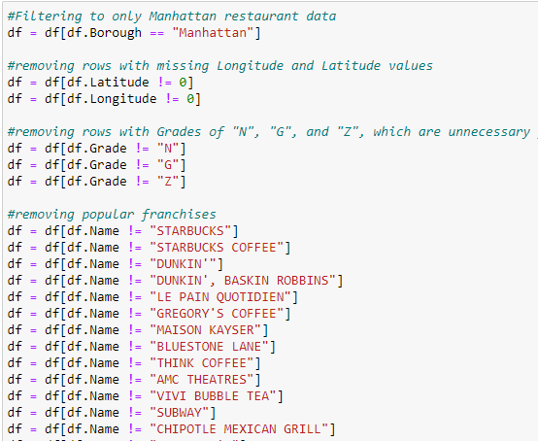
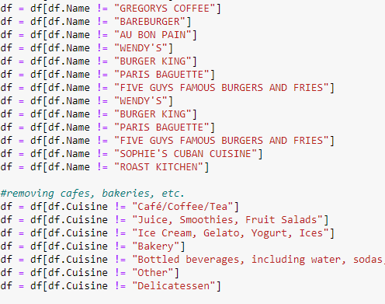
Data ETL
Because the data set was so large (430K rows) and our visual was a Leaflet map, we had to drastically cut down our data. We ended up only using Manhattan restaurants, removing any pending grades (which are not public facing), removing franchises, and removing certain cuisines like coffee shops.

Slide 6
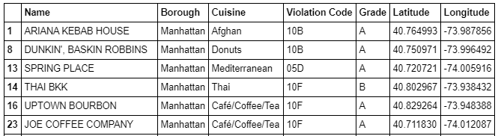
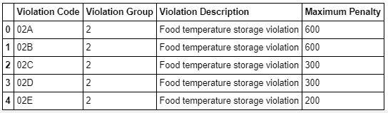
Data ETL
We also manually categorized the violation codes into more manageable buckets (food storage related, facility related, vermin related, etc.) and added maximum violation penalty fees based on the DOH violation dictionary.

Slide 7
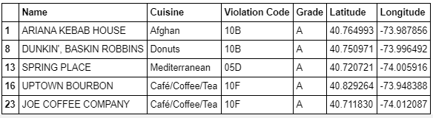
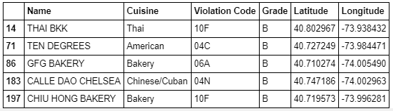
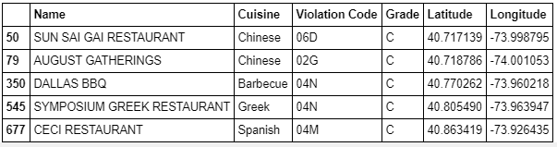
Clean Datasets
Even after this, we still ended up with around ~75K data points to map out. So to offload the expected lag time on our flask app/leaflet map, we separated the data by their grades before uploading into mongoDB.

Slide 8
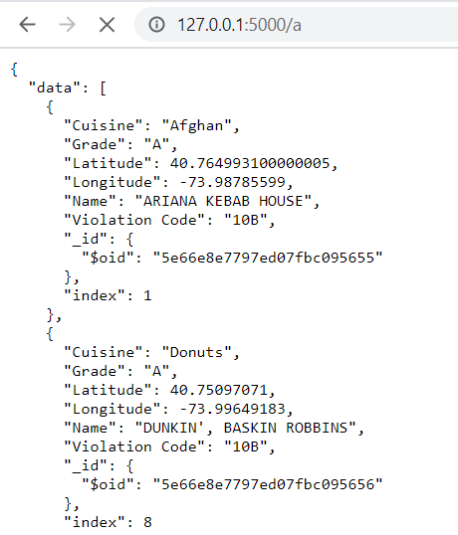
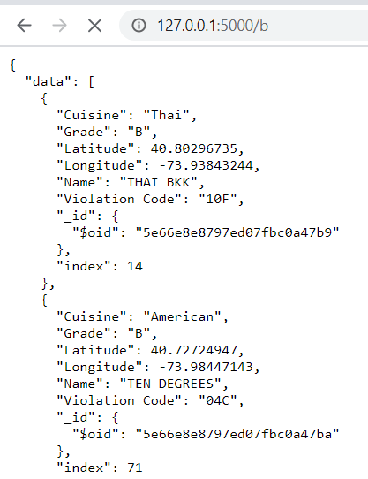
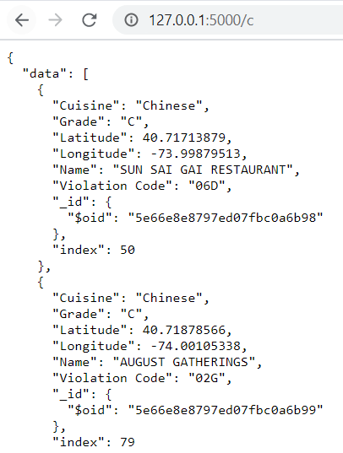
Flask App
From the A, B, C datasets, we uploaded each into a mongoDB which then get uploaded into our Flask App and to the local host.

Slide 9
Let’s check out the front end

Slide 10
conclusion
FINDINGS
We couldn’t definitively prove the DOH penalty system is rigged to generate revenue from this data. On the bright side, at least most restaurants have A ratings which is beneficial to all parties involved.
SURPRISES
We didn’t anticipate this much data cleaning – we didn’t realize in the beginning that Leaflet visuals work better with a certain amount of data because too many markers can make it overwhelming and also lag the website.
SHOULD’VE, WOULD’VE,
COULD’VE
If we had more time, we would have figured out how to load a Leaflet map with much more data (Queens, Bronx, Brooklyn, Staten Island) and also done some other interesting plot.ly charts looking deeper into violation codes by borough or cuisine.

Slide 11
Questions?

Slide 12
Thank you!

